Slide 1

Kickstarter Project
Allyssa Utecht, Jimmy Horvath, Andrew Plate

Slide 2
Source:
“Predicting Outcomes in Crowdfunding Campaigns with Textual, Visual, and Linguistic Signals”
Kaminski and Hopp
Focus on impact of visual and linguistic characteristics on consumer perception
Text that is more abstract and “emotionally salient” → increase campaign success more
As opposed to text related to finance, texts that tries to elicit excitement and inclusion increases campaign success
In the startup stage, objective info and quantitative facts are limited, so positive psychological language is important
Focused only on technology and product-design related campaigns

Slide 3
Source:
“Money Talks: A Predictive Model on Crowdfunding Success Using Project Description”
Viewed project descriptions as marketing tools for crowdfunding campaigns
Valued 3 argument dimensions
Amount of data
Ease of understanding (fog)
Objectivity
Proposed model, with these variables included, provided a 73% rate of accuracy
“These results together show that our newly introduced variables have significant practical impacts on the funding success of projects”
Similarly, our group has focused on the readability and length of kickstarter campaigns in determining their success rates
Notes:
Pulled from a variety of sources, including both the articles Professor Davis provided and ones we found on our own. After researching and reading these articles, we decided that _ were the most important factors to look at.

Slide 4
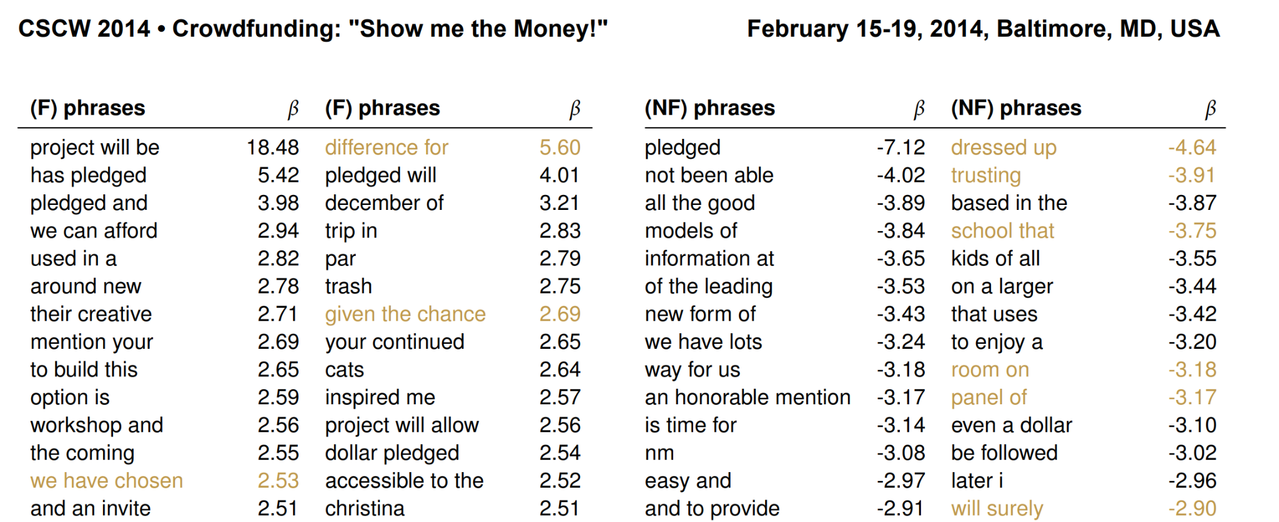
Source: “The Language that Gets People to Give: Phrases that Predict Success on Kickstarter”
Reasons
Social Proof, Social Identity, Liking, General Phrases, Scarcity, Authority, LIWC and Sentiment, General Phrases
Liking: People are more likely to comply with a person or product if they like them. Positive remarks about another person’s attitudes and performance increases liking

Slide 5
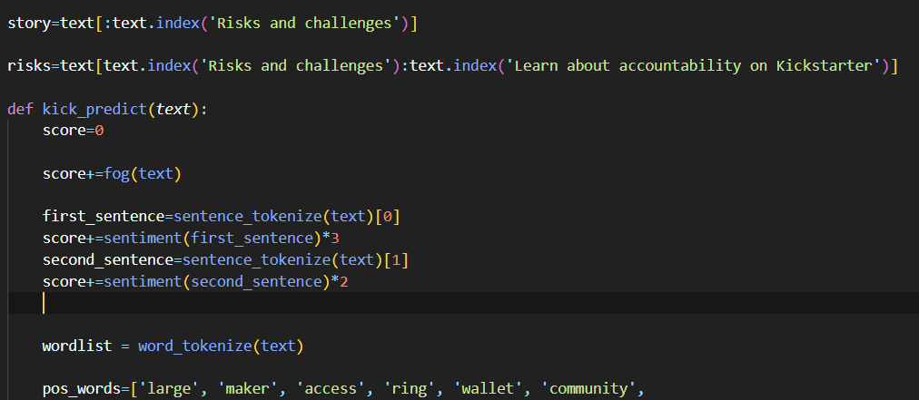
What Surprised Us / What We Have Learned
Surprising | Takeaways
Model Errors with Story and Risks Risks and Story sections deem different analyses Sheer Kickstarter Project quantity | Include info below both variables Will move the initial code from under risks to story Must be decisive on sample size

Slide 6
Approach
Created fog and sentiment functions
Separated text into “Story” and “Risks”
Fog of entire text
Tokenizing the text and creating a wordlist
Sentiment analysis - created a lexicon of positive and negative words and phrases, based on lists provided in sources
Set score to be 0 or 1
Tested model on a set of sample Kickstarter campaigns that were from the Technology and Product Design categories - 16 successful, and 14 unsuccessful

